Slide 1
Digital Portfolio
STUDENT NAME: SWETHA.R
REGISTER NO AND NMID: 2422K0976 AND 39536BFBAAA8D7EBCC84DF5BFFC65752
DEPARTMENT: BSC COMPUTER SCIENCE
COLLEGE: COLLEGE/ UNIVERSITY: TIRUPUR KUMARAN COLLEGE FOR WOMEN / BHARTHIYUNIVERSITY

Slide 2
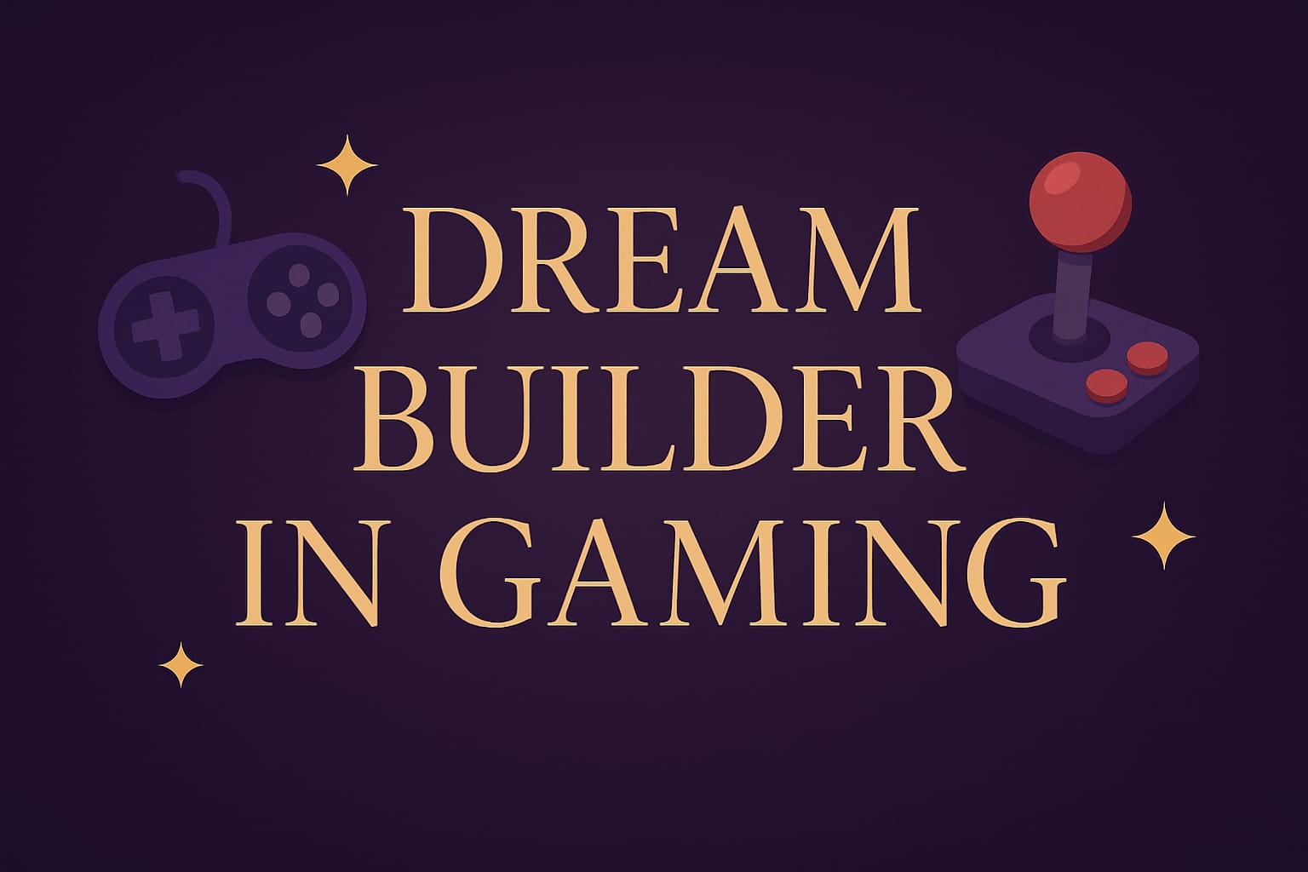
PROJECT TITLE

Slide 3


AGENDA
Problem Statement
Project Overview
End Users
Tools and Technologies
Portfolio design and Layout
Features and Functionality
Results and Screenshots
Conclusion
Github Link
3/21/2024 Annual Review

Slide 4

PROBLEM STATEMENT
In today’s competitive game development industry, showcasing one’s skills, projects, and expertise is essential for career growth and opportunities. Many mobile game developers struggle to present their work in an interactive, professional, and accessible way. A traditional resume does not effectively highlight creativity or project interactivity. Therefore, there is a need for a personal portfolio website that can clearly display a developer’s skills, projects, and contact details while being visually appealing, responsive, and user-friendly.

Slide 5

PROJECT OVERVIEW
The Mobile Game Developer Portfolio is a responsive website that showcases a developer’s skills, projects, and contact details. It offers a professional platform to highlight creativity and technical expertise in game development. The portfolio helps in building a strong online presence and enables easier connection with recruiters, clients, and gaming communities.

Slide 6

WHO ARE THE END USERS?
Recruiters & Employers – to evaluate the developer’s skills and projects for job opportunities.
Clients – to explore the developer’s past work before offering freelance or contract projects.
Gaming Enthusiasts & Community – to learn more about the developer’s creative contributions.

Slide 7

TOOLS AND TECHNIQUES
HTML5 – for structuring the portfolio content and sections.
CSS3 – for styling, layout design, responsiveness, and hover effects.
JavaScript – for interactivity (e.g., theme toggle, navigation effects).
Responsive Design Techniques – to ensure compatibility across mobile and desktop devices.

Slide 8
POTFOLIO DESIGN AND LAYOUT
The portfolio uses a responsive and modern design with clear sections for About, Skills, Projects, and Contact.
A sticky header allows smooth navigation across the site.
Simple layouts and hover effects give it a professional and user-friendly look.
8

Slide 9
FEATURES AND FUNCTIONALITY
The portfolio is designed with a responsive layout for both desktop and mobile devices. It includes smooth navigation with a sticky header, interactive hover effects, and a dark/light theme toggle for better user experience. The clean design highlights About, Skills, Projects, and Contact sections, ensuring the portfolio is both professional and user-friendly.

Slide 10
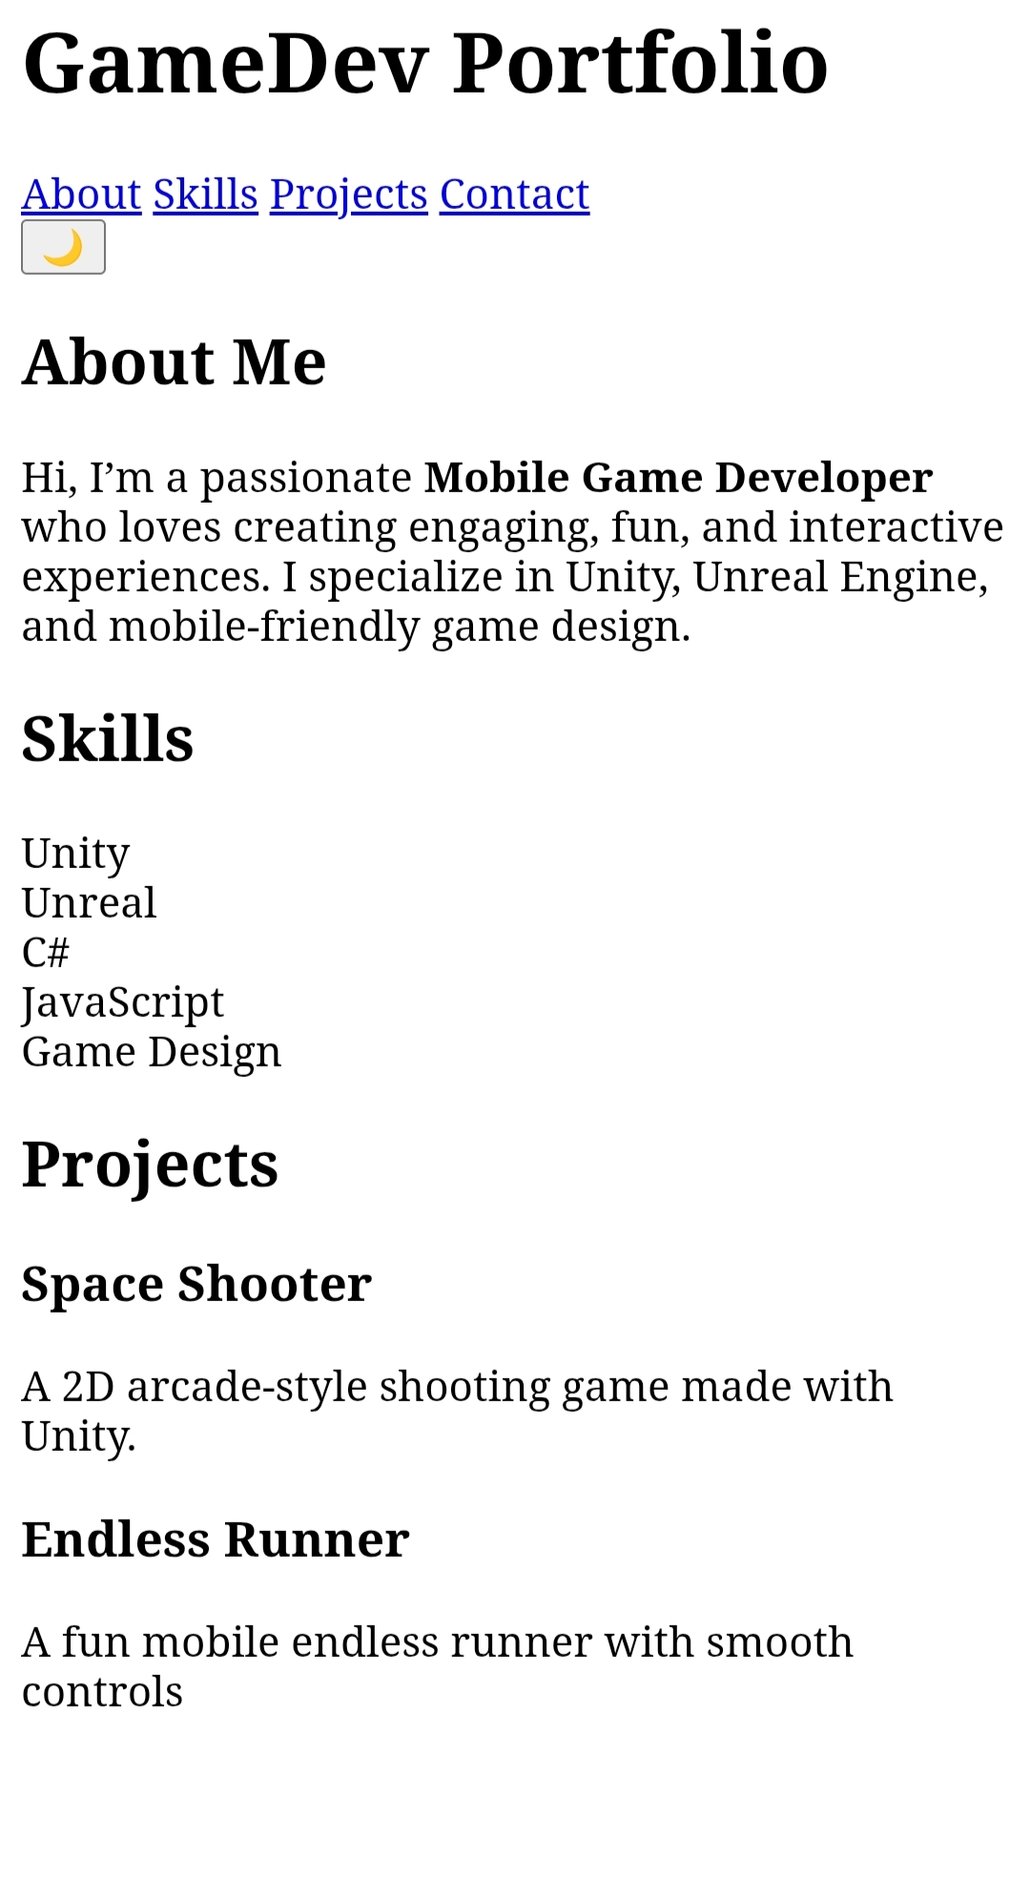

RESULTS AND SCREENSHOTS
3/21/2024 Annual Review
10

Slide 11
CONCLUSION
The Mobile Game Developer Portfolio provides a professional platform to showcase skills, projects, and creativity. Its responsive design ensures accessibility on all devices, while the clean layout helps recruiters and clients easily explore the developer’s work. This portfolio strengthens the developer’s online presence and opens opportunities in the gaming industry.
11

